Slide 1

Supermarket Sales Analysis Report
Insights from the Sales Data Visualization
By
Ajibola Samson Tobi

Slide 2

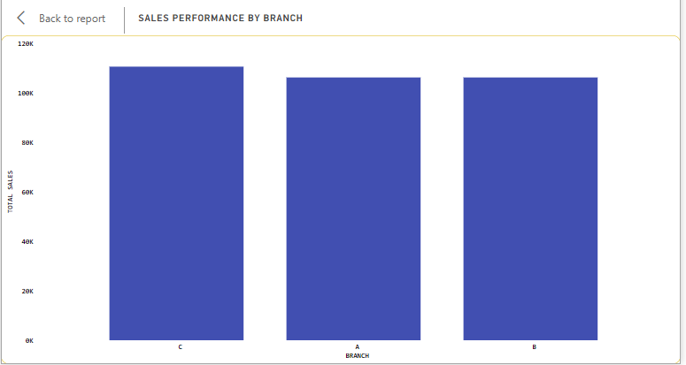
Sales Performance by Branch
Key points:
Branch C shows the highest sales performance compared to Branches A and B.
Significant factors contributing to Branch C’s success includes its strategic location and its mode of receiving payment and also its customer relationship approach because further analysis showed that Branch C has the highest average rating (7.075) from customers.

Slide 3
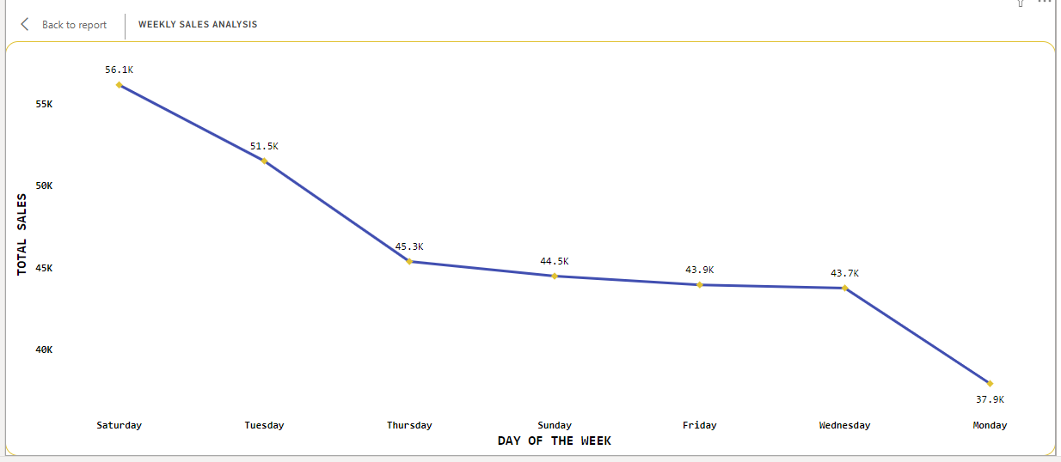
Weekly Sales Analysis
Key points:
Saturday emerges as the best sales day in all branches indicating strong consumer activity during weekends.
Understanding that weekends drive higher sales, this can help the company plan its staffing, inventory, and marketing strategies to optimize sales further.

Slide 4

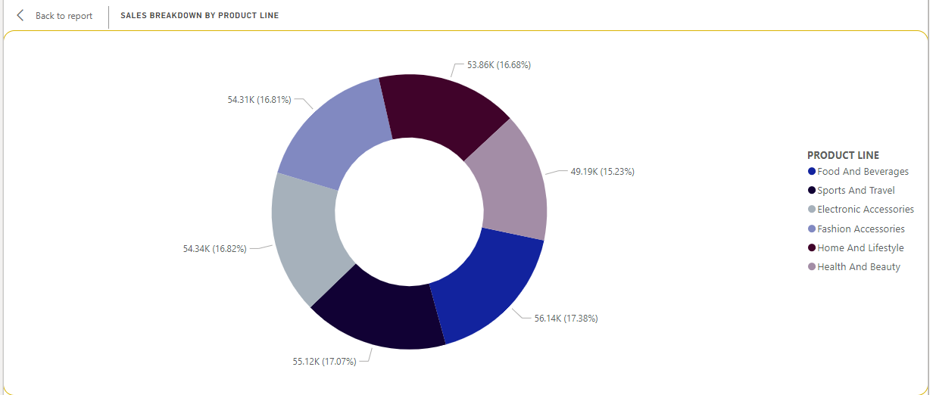
Sales Breakdown by Product Line
Key Points
This chart highlights the product lines contributing most to sales, with food and beverages being the top categories.
These insights should guide the company in inventory management, marketing strategies, and promotional efforts to capitalize on high demand products.

Slide 5

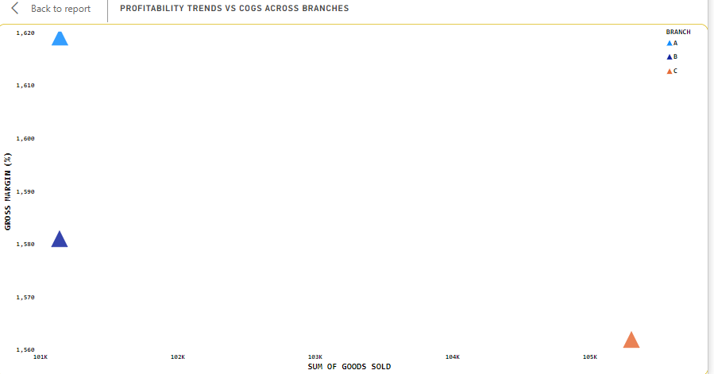
Profitablity Trends vs Cost of Goods Sold
Key Points
These are the trends in profitability across branches, revealing how effectively each branch manages its costs relative to sales.
The analysis shows that each branch are performing better financially and this indicates that they are able to generate higher profits from each sale, this is due to efficient cost management and higher sales volume

Slide 6

Conclusion & Recommendation
KEY POINTS
Strengths:
Branch C demonstrated exemplary performance in sales, customer satisfaction and transaction volume
Opportunities for Improvement:
The company can should analyze and implement successful practices from Branch C in A and B.
The company should focus on maximizing sales during weekends and consider promotional campaigns to boost weekday sales.
The company can continue to monitor COGS to enhance profitability across all branches.
The company should also use customer feedback to improve service quality and product offerings.

Slide 7

THANK YOU

